Slide 1
English Style Housing
By: Drew Jackson

Slide 2
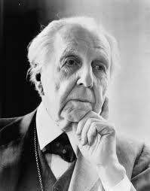
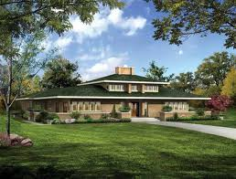
Prairie Style Architecture
Designed by Frank Lloyd Wright
Late 1800’s into early 1900’s
Low pitched roofing.
Central Chimney.
One or two stories.
Materials usually used are plaster and concrete block.

Slide 3
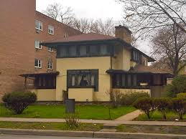
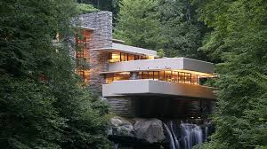
Characteristics Of Prairie Style Homes
Central Chimney →
Wide overhangs-→
Some of the houses have waterfalls

